Slide 1
ITMD 421 – Data Modeling and Applications
Aastha Gupta
Lecture 6
October 2nd, 2017

Slide 2
Objectives
SQL Joins
Equi-Join
Non Equi-Join
Cross-Joins
Sub Queries

Slide 3
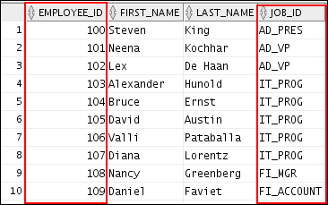
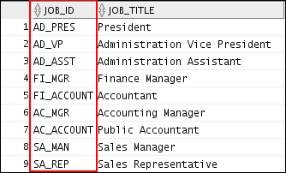
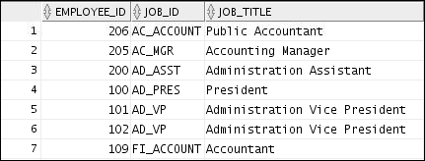
Obtaining Data from Multiple Tables
EMPLOYEES
JOBS
…

Slide 4
Obtaining Data from Multiple Tables
Data that is distributed among different tables can be combined into a single set of tuples using different types of joins:
Equi-join
Natural join
Inner join
Outer join (left, right, full)

Slide 5
Table/Column Alias
SELECT column1, column2....
FROM table_name AS alias_name
WHERE [condition];
Rename a table or a column temporarily by giving another name.
Table Aliases are used during SQL joins.

Slide 6
Cartesian Products
Cartesian product is a join of every row of one table to every row of another table.
A Cartesian product generates a large number of rows and the result is rarely useful.

Slide 7
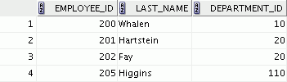
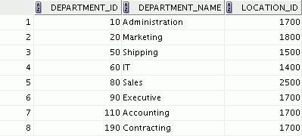




Generating a Cartesian Product
EMPLOYEES (20 rows)
DEPARTMENTS (8 rows)
…
Cartesian product: 20 x 8 = 160 rows

Slide 8
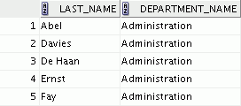

Creating Cross Joins
SELECT last_name, department_name
FROM employees
CROSS JOIN departments ;
…
A CROSS JOIN is a JOIN operation that produces the Cartesian product of two tables.
To create a Cartesian product, specify the CROSS JOIN in your SELECT statement.

Slide 9
Equi-Join
SELECT …
FROM TABLE1, TABLE2 WHERE TABLE1.Attribute = TABLE2.Attribute;
An equi-join keeps only those rows where the two combined rows agree on the shared attribute(s):

Slide 10
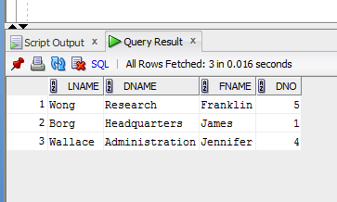
Equi-Join
select LAST_NAME,DEPARTMENT_NAME, FIRST_NAME, departments.DEPARTMENT_IDFROM employees,departmentsWHERE departments.MANAGER_ID = employees.MANAGER_ID;;
CDM CSC 455 – Databases for Large Scale Analytics
An equi-join uses the equal sign as the comparison operator.

Slide 11
Natural Joins
SELECT * FROM table1 NATURAL JOIN table2;
The NATURAL JOIN clause is based on all the columns that have the same name in two tables.
It selects rows from the two tables that have equal values in all matched columns.
The same names columns of the associated table are returned only once
If the columns having the same names have different data types, an error is returned.

Slide 12
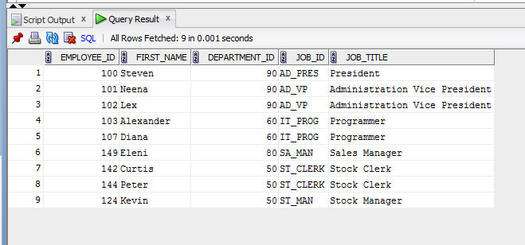
Retrieving Records with Natural Joins
SELECT employee_id, first_name, job_id, job_title
from employees NATURAL JOIN jobs;

Slide 13
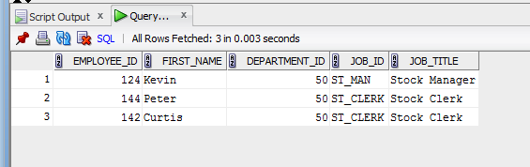
Retrieving Records with Natural Joins
SELECT employee_id, first_name,department_id,
job_id, job_title
from employees NATURAL JOIN jobs
where department_id = 50;

Slide 14
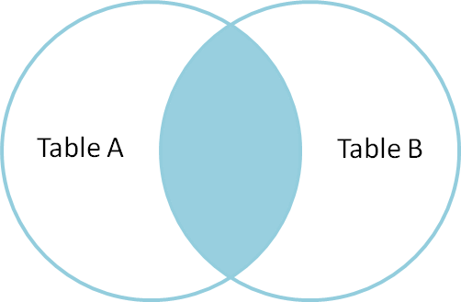
INNER Joins
The join of two tables returning only matched rows is called an INNER join.
The inner joins enables a maximum of 256 tables that can be joined at the same time.

Slide 15
Inner Join Syntax
SELECT table1.column1,table1.column2,table1.column3,
table2.column1,table2.column2,table2.column3…
FROM table 1
INNER JOIN table2
ON table1.column_name = table2.column_name;

Slide 16
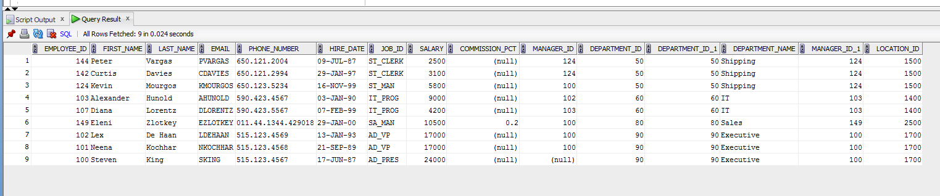
Inner Join
select * from employees e
INNER JOIN departments d
ON e.department_id = d.department_id;

Slide 17
INNER Versus OUTER Joins
In SQL:1999, the join of two tables returning only matched rows is called an INNER join.
A join between two tables that returns the results of the INNER join as well as the unmatched rows from the left (or right) table is called a left (or right) OUTER join.
A join between two tables that returns the results of an INNER join as well as the results of a left and right join is a full OUTER join.

Slide 18
OUTER Joins
The join of two tables returning all matched rows and non matching rows from one or both tables.
The outer join can be performed on only 2 tables at a time.
Three types of outer join
Left Outer Join
Full Outer Join
Right Outer Join

Slide 19
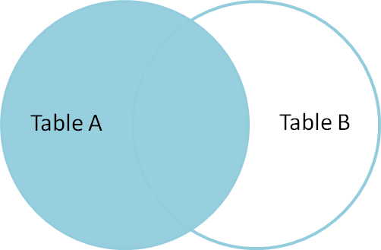
LEFT OUTER JOIN
Left joins include all rows from the first (left) table, even if there are no matching rows in the second (right) table.

Slide 20
LEFT OUTER JOIN SYNTAX
SELECT *
FROM table1
LEFT [ OUTER ] JOIN table2
ON table1.column_name=table2.column_name;

Slide 21
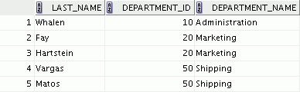
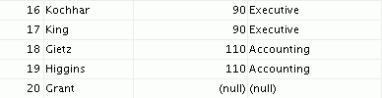
LEFT OUTER JOIN
SELECT e.last_name, e.department_id, d.department_name
FROM employees e LEFT OUTER JOIN departments d
ON (e.department_id = d.department_id) ;
…

Slide 22
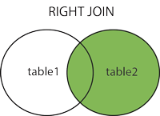
RIGHT OUTER JOIN
Right joins include all rows from the second (right) table, even if there are no matching rows in the first (left) table.

Slide 23
RIGHT OUTER JOIN SYNTAX
SELECT *
FROM table1
RIGHT [ OUTER ] JOIN table2
ON table1.column_name=table2.column_name;

Slide 24
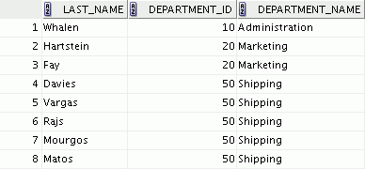

RIGHT OUTER JOIN
SELECT e.last_name, d.department_id, d.department_name
FROM employees e RIGHT OUTER JOIN departments d
ON (e.department_id = d.department_id) ;
…

Slide 25
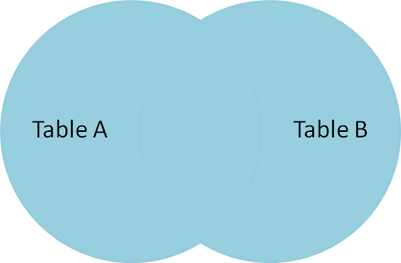
FULL OUTER JOIN
Select all records from left (first) table and right (second) table, regardless of whether the join condition is met or not.
No full join in MySQL

Slide 26
FULL OUTER JOIN SYNTAX
SELECT *
FROM table1
FULL OUTER JOIN table2
ON table1.column_name=table2.column_name;

Slide 27
Qualifying Ambiguous Column Names
Use table prefixes to qualify column names that are in multiple tables.
Instead of full table name prefixes, use table aliases.
Table alias gives a table a shorter name:
Keeps SQL code smaller, uses less memory
Use column aliases to distinguish columns that have identical names, but reside in different tables.

Slide 28
Applying Additional Conditions to a Join
SELECT e.employee_id, e.last_name, e.department_id,
d.department_id, d.location_id
FROM employees e JOIN departments d
ON (e.department_id = d.department_id)
AND e.manager_id = 149 ;
Or
SELECT e.employee_id, e.last_name, e.department_id,
d.department_id, d.location_id
FROM employees e JOIN departments d
ON (e.department_id = d.department_id)
WHERE e.manager_id = 149 ;
Use the AND clause or the WHERE clause to apply additional conditions:

Slide 29
Non-Equi-Join
An sql join condition that uses some other comparison operator other than the equal sign like >, <, >=, <=

Slide 30
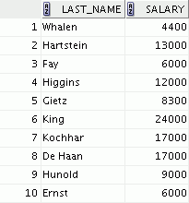
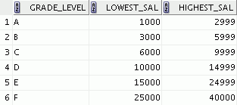

Nonequijoins
EMPLOYEES
JOB_GRADES
The JOB_GRADES table defines the LOWEST_SAL and HIGHEST_SAL range of values for each GRADE_LEVEL. Therefore, the GRADE_LEVEL column can be used to assign grades to each employee.
…

Slide 31
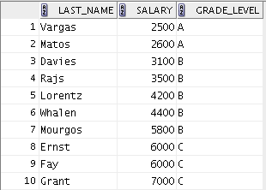
Retrieving Records with Nonequijoins
SELECT e.last_name, e.salary, j.grade_level
FROM employees e JOIN job_grades j
ON e.salary
BETWEEN j.lowest_sal AND j.highest_sal;
…

Slide 32
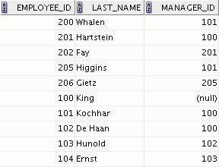
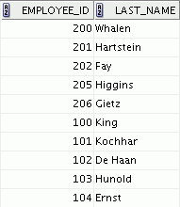
Self-Joins
EMPLOYEES (WORKER)
EMPLOYEES (MANAGER)
…

Slide 33
Self-Joins
SELECT …
TABLE1 as Alias1, TABLE as Alias2 ON Alias1.AttributeA = Alias2.AttributeB;
Joins the table to itself

Slide 34
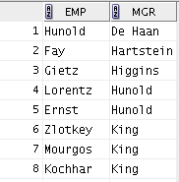
Self-Joins
SELECT worker.last_name emp, manager.last_name mgr
FROM employees worker JOIN employees manager
ON (worker.manager_id = manager.employee_id);
Joins the table to itself

Slide 35
Example
Create the messaging database
(use the script provided)
Add yourself to the Person table.
Alter the Person table by adding a new property of your choice with the data type of your choice.
Update your record in the Person table by setting some value to your new property.

Slide 36
Example
Delete the Diana Taurasi record.
Alter the Contact List table and Add column for Favorite
Set Michael Phelps as everyone's favorite contact
Set every contact who is NOT Michael Phelps to "n" (contact_id <> 1)

Slide 37
Example
Populate the Contact List table with new records.
Add at least 3 contacts to your contact list.
Add yourself as the contact for at least 3 people.
Make sure that you provide a value (y or n) for the new Favorite column.

Slide 38
Example
Create the Image table.
(image_id,image_name,image_location)
Create the Message-Image intersection table.
Add 5 new records to the Image table.
Add 5 new records to the Message-Image intersection table.
Add 5 new records to the Message-Image intersection table.
Make sure that at least one message has multiple images.

Slide 39
Example
Find all of the messages that Michael Phelps sent.
Display the following columns:
Sender's first name
Sender's last name
Receiver's first name
Receiver's last name
Message ID
Message
Message Timestamp

Slide 40
Example
Find the number of messages sent for every person.
Display the following columns:
Count of messages
Person ID
First Name
Last Name

Slide 41
Example
Find all of the messages that have at least one image attached using INNER JOINs.For messages with multiple images, display only the first image for the message.
Display the following columns:
Message ID
Message
Message Timestamp
First Image Name
First Image Location

Slide 42



Nested/Sub/Inner Query
Who is hired after Davies?
Main query:
Determine the names of all employees who were hired after Davies?
Subquery:
When was Davies hired?

Slide 43
Nested Query Syntax
SELECT select_list
FROM table
WHERE expr operator
(SELECT select_list
FROM table);
The subquery (inner query) executes before the main query (outer query).
The result of the subquery is used by the main query.

Slide 44
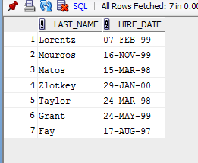
Nested Query
SELECT last_name, hire_date
FROM employees
WHERE hire_date > (SELECT hire_date
FROM employees
WHERE last_name = 'Davies');

Slide 45
Nested/Sub/Inner Query
The result of one query may be needed by another to compute its result:
One query (the nested query or subquery) is nested within another (the outer query)
Outer query uses the result of the nested query, which can be either a table or a single value
Nested query usually appears in a WHERE or HAVING clause (rarely, a FROM)

Slide 46
Guidelines for Using Subqueries
Enclose subqueries in parentheses.
Place subqueries on the right side of the comparison condition for readability. (However, the subquery can appear on either side of the comparison operator.)
Use single-row operators with single-row subqueries and multiple-row operators with multiple-row subqueries.

Slide 47
Guidelines for Using Subqueries
Single-row subquery
Multiple-row subquery
Main query
Subquery
returns
ST_CLERK
Main query
returns
ST_CLERK
SA_MAN
Subquery

Slide 48
Single-Row Subqueries
Operator
Meaning
=
Equal to
>
Greater than
>=
Greater than or equal to
<
Less than
<=
Less than or equal to
<>
Not equal to
Return only one row
Use single-row comparison operators

Slide 49
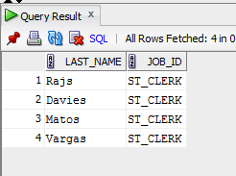
Executing Single-Row Subqueries
SELECT last_name, job_id
FROM employees
WHERE job_id =
(SELECT job_id
FROM employees
WHERE employee_id = 141);
Display the employees whose job ID is the same as that of employee 141:

Slide 50
Executing Single-Row Subqueries
Display the list of employees who have same job as ‘Taylor’ but earn more salary than him.

Slide 51
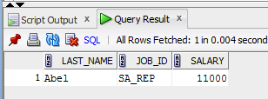
Executing Single-Row Subqueries
SELECT last_name, job_id, salary
FROM employees
WHERE job_id =
(SELECT job_id
FROM employees
WHERE last_name = 'Taylor')
AND salary >
(SELECT salary
FROM employees
WHERE last_name = 'Taylor');

Slide 52
Multiple-Row Subqueries
Operator
Meaning
IN
Equal to any member in the list
ANY
Must be preceded by =, !=, >, <, <=, >=. Returns TRUE if at least one element exists in the result set of the subquery for which the relation is TRUE.
ALL
Must be preceded by =, !=, >, <, <=, >=. Returns TRUE if the relation is TRUE for all elements in the result set of the subquery.
Return more than one row
Use multiple-row comparison operators

Slide 53
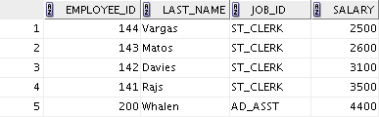

ANY Operator in Multiple-Row Subqueries
SELECT employee_id, last_name, job_id, salary
FROM employees
WHERE salary < ANY
(SELECT salary
FROM employees
WHERE job_id = 'IT_PROG')
AND job_id <> 'IT_PROG';
…

Slide 54

ALL Operator in Multiple-Row Subqueries
SELECT employee_id, last_name, job_id, salary
FROM employees
WHERE salary < ALL
(SELECT salary
FROM employees
WHERE job_id = 'IT_PROG')
AND job_id <> 'IT_PROG';

Slide 55
Multiple-Column Subqueries
A multiple-column subquery returns more than one column to the outer query.
Column comparisons in multiple column comparisons can be pairwise or nonpairwise.
A multiple-column subquery can also be used in the FROM clause of a SELECT statement.

Slide 56
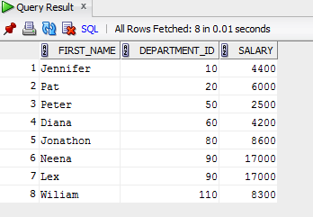
Multiple-Column Subqueries
SELECT first_name, department_id, salary
FROM employees
WHERE (salary, department_id) IN
(SELECT min(salary), department_id
FROM employees
GROUP BY department_id)
ORDER BY department_id;
Display all the employees with the lowest salary in each department

Slide 57
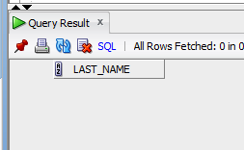
Null Values in a Subquery
SELECT emp.last_name
FROM employees emp
WHERE emp.employee_id NOT IN
(SELECT mgr.manager_id
FROM employees mgr);

Slide 58
Thank You!

